Slide 1
Introduction to Networking
This lecture is mainly based on the powerpoint slides by Prof. Mark Stamp, Dr. Junjie Zhang

Slide 2
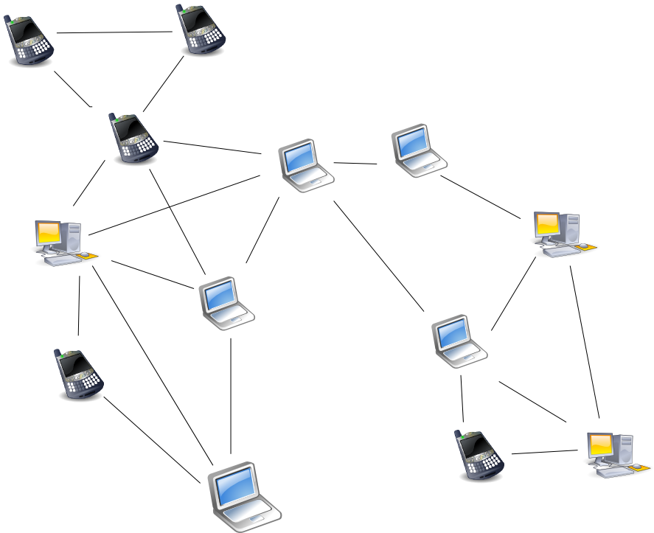
Network Basics
Network
A network is a set of protocols, software, and hardware used to exchange information among different systems.

Slide 3
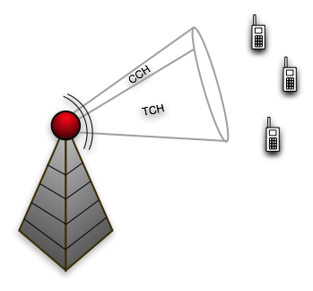

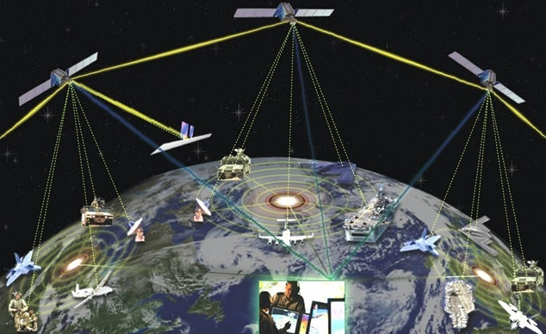
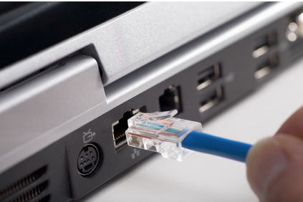
Network Types
Telephone Network
Cellular Networks
……
Satellite Networks
The Internet

Slide 4

The Internet
The Internet is a global-scale network
Offers general-purpose service
Has billions of users worldwide
Consists of millions of “smaller” networks
Supports numerous types of services (Web, Email, VoIP……)

Slide 5
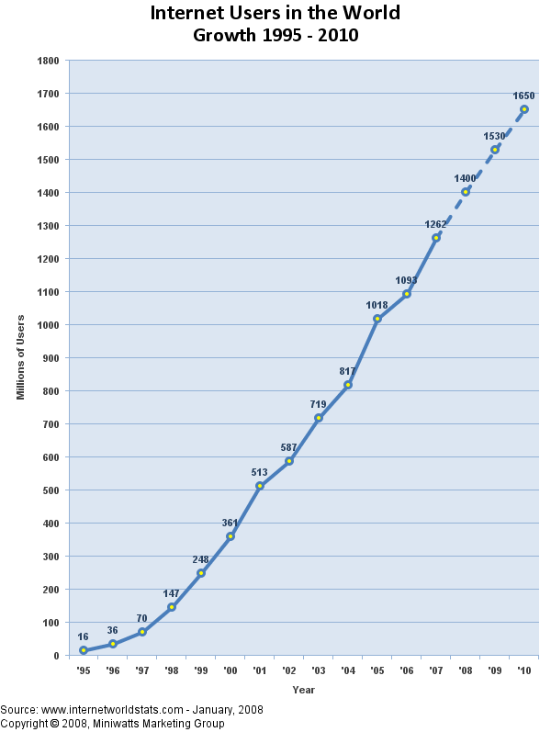
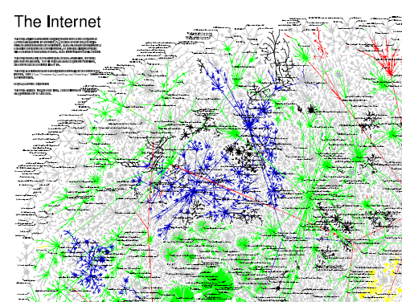

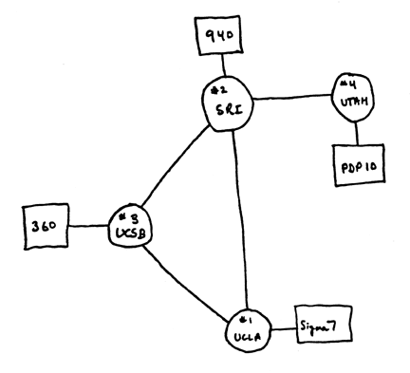
Timeline Of The Internet
1969
2010

Slide 6
TCP/IP
The Internet mainly uses the standard Internet protocol suite (a.k.a., TCP/IP).
TCP/IP
Notes:
TCP/IP are usually implemented in the OS.

Slide 7
TCP/IP suite
Physical Layer: To transmission bits over a media
Data Link Layer: transferring datagram from one node to physically adjacent node over a link, using MAC address
Network Layer: To move packets from source to destination
TCP layer: provides a message delivery between two hosts (two processes), error control
Application Layer: handles the details of the particular application, using TCP/IP suite
The data is sent down the protocol stack
Each layer adds to the data by prepending headers
application
transport
network
Data link
physical
Notes:
Physical Layer: Coaxial cable, Optical fiber, Wireless communications
Data Link Layer: transferring datagram from one node to physically adjacent node over a link, using MAC address, includes device driver and network interface card
IP (Internet Protocol): To move packets from source to destination, using IP address
TCP layer (Transmission Control Protocol): provides a reliable flow of data between two hosts
Application Layer: handles the details of the particular application, using TCP/IP suite, FTP, HTTP, Web service, SMTP
MTU: Maximum transmission unit: a 1500-byte packet, the largest allowed by Ethernet at the network layer
The data is sent down the protocol stack
Each layer adds to the data by prepending headers
MTU: Maximum Transmission Unit

Slide 8
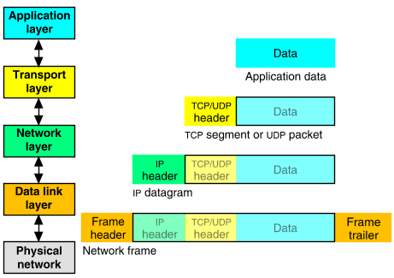
Packet Encapsulation
The data is sent down the protocol stack
Each layer adds to the data by prepending headers
22Bytes
20Bytes
20Bytes
4Bytes
64 to 1500 Bytes
Notes:
User Datagram Protocol (UDP): With UDP, computer applications can send messages, in this case referred to as datagrams, to other hosts on an Internet Protocol (IP) network. Prior communications are not required in order to set up communication channels or data paths.

Slide 9
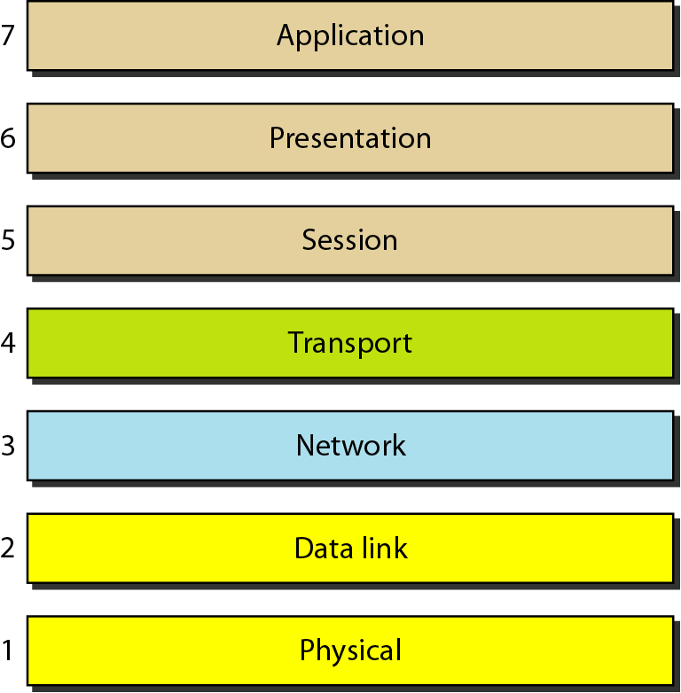
Seven layers of the OSI model
Notes:
Session: Interhost communication: NFS, RPC, SQL
Presentation: JPEG, MPEG, ASCII
Application: HTTP, FTP, DNS, SMTP

Slide 10
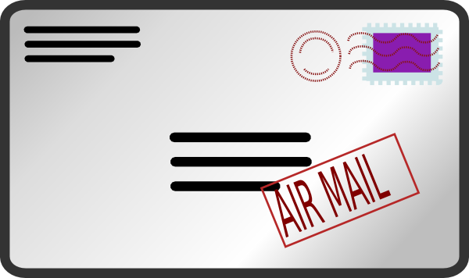
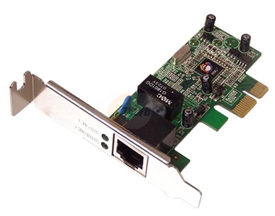
Internet Addressing
The Internet Protocol (IP) address
Logical address
Manually or automatically assigned to a network interface controller (NIC)
32 bits for IPv4
Media Access Control (MAC) address
Physical address
Assigned to a NIC by the manufacturer and are stored in hardware or firmware
48 bits
Notes:
MAC address: physical address, assigned by the manufacturer, unique

Slide 11
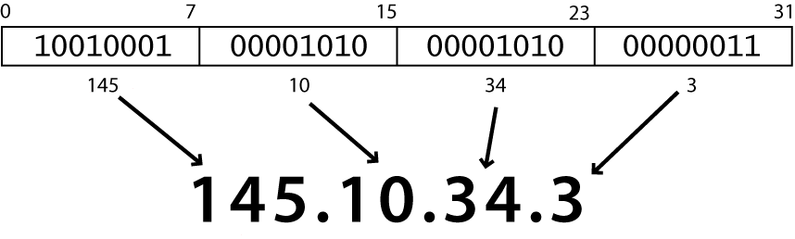
Internet Addressing
An address is usually converted to a human-readable notation based on octets.
Notes:
Here we have a demo, ifconfig to show the IP address, and MAC address.

Slide 12
Demo
Here we have a demo, ifconfig to show the IP address, and MAC address.

Slide 13



Network Layer
Mailing Service
Content
Address 1
Address 2

Slide 14
Network Layer
Send a packet to a networked computer
The Internet
IP1
IP2
Computer 1
Address: IP1
Computer 2
Address: IP2
Packet Header
Payload/data
IP1
IP2
payload

Slide 15
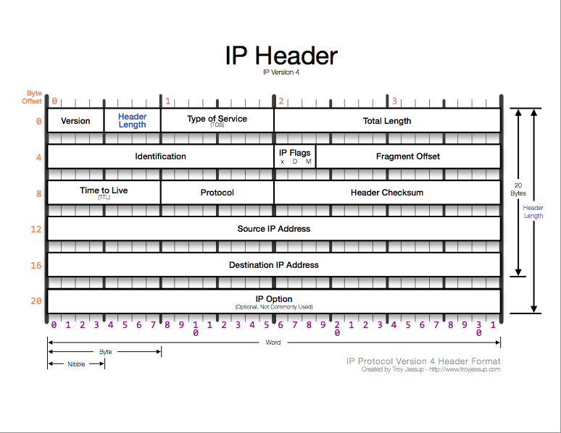
Network Layer
The IPv4 Header
IP Header
Payload/data
Notes:
Protocol: 1 = ICMP, 6 = TCP, 17 = UDP
ICMP: Internet Control Message Protocol

Slide 16
Network Layer
The IPv4 Header
IP Header
Payload/data
Field Purpose
TTL Time To Live - Max # of hops
Protocol Higher level protocol (1=ICMP,
6=TCP, 17=UDP)
Checksum Checksum for the IP header
Source IA Originator’s Internet Address
Dest. IA Final Destination Internet Address
Options Source route, time stamp, etc.
Data... Higher level protocol data
Field Purpose
Vers IP version number
Len Length of IP header (4 octet units)
TOS Type of Service
T. Length Length of entire datagram (octets)
Ident. IP datagram ID (for frag/reassembly)
Flags Don’t/More fragments
Frag Off Fragment Offset
Notes:
Protocol: 1 = ICMP, 6 = TCP, 17 = UDP
ICMP: Internet Control Message Protocol

Slide 17

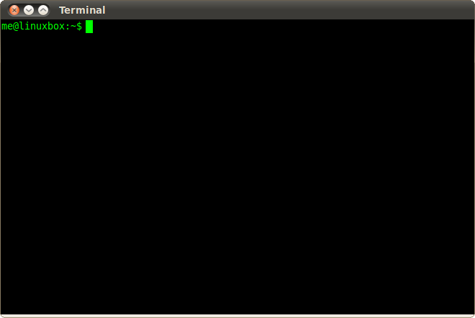
Transport Layer
Send a packet to an application in a networked computer
The Internet
Insufficient!
IP1
IP2
payload
Computer 1
IP1
Computer 2
IP2
Web Service
SSH
Service

Slide 18
Transport Layer
Send a packet to an application in a networked computer
The Internet
Network
Layer
Transport
Layer: UDP & TCP
IP1
IP2
Port_A
Port_C
payload
Computer 2
IP2
Computer 1
IP1
Port_C
Port_D
Port_A
Port_B
Web Service
SSH
Service
Notes:
Port number is associated with a specific process (a specific application).
FTP port: 21
HTTP port: 80
HTTPS port: 443
DNS port: 53
SSH: 22

Slide 19
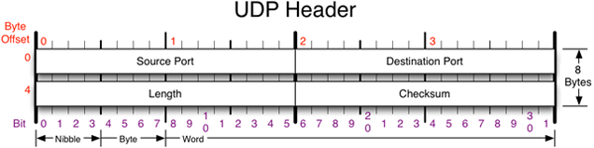
Transport Layer
The User Datagram Protocol (UDP) Header

Slide 20
Transport Layer
The User Datagram Protocol (UDP) Header
Field Purpose
Source Port 16-bit port number identifying originating application
Destination Port 16-bit port number identifying destination application
Length Length of UDP datagram (UDP header + data)
Checksum Checksum of IP pseudo header, UDP header, and data

Slide 21
Transport Layer
The User Datagram Protocol (UDP) Header
UDP offers best-effort, unreliable service
E.g., if a packet is dropped, UDP does not have any mechanism to inform networked nodes.

Slide 22
Typical applications of UDP
Where packet loss etc is better handled by the application than the network stack
Where the overhead of setting up a connection isn’t wanted
VOIP
NFS – Network File System
Most games

Slide 23
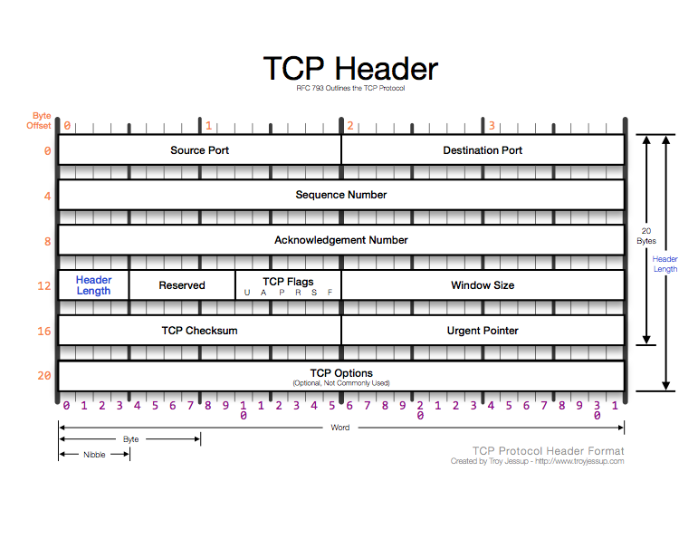
Transport Layer
The Transmission Control Protocol (TCP) Header

Slide 24
Transport Layer
The Transmission Control Protocol (TCP) Header
Field Purpose
Source Port Identifies originating application
Destination Port Identifies destination application
Sequence Number Sequence number of first octet in the segment
Acknowledgment # Sequence number of the next expected octet (if ACK flag set)
Len Length of TCP header in 4 octet units
Flags TCP flags: SYN, FIN, RST, PSH, ACK, URG
Window Number of octets from ACK that sender will accept
Checksum Checksum of IP pseudo-header + TCP header + data
Urgent Pointer Pointer to end of “urgent data”
Options Special TCP options such as MSS and Window Scale
Notes:
The PSH flag in the TCP header informs the receiving host that the data should be pushed up to the receiving application immediately.
The URG flag is used to inform a receiving station that certain data within a segment is urgent and should be prioritized.

Slide 25
TCP
Reliable, full-duplex, connection-oriented, stream delivery
Interface presented to the application doesn’t require data in individual packets
Data is guaranteed to arrive, and in the correct order without duplications
Or the connection will be dropped
Imposes significant overheads

Slide 26
Applications of TCP
Most things!
HTTP, FTP, …
Saves the application a lot of work, so used unless there’s a good reason not to

Slide 27
TCP implementation
Connections are established using a three-way handshake
Data is divided up into packets by the operating system
Packets are numbered, and received packets are acknowledged
Connections are explicitly closed
(or may abnormally terminate)

Slide 28
Transport Layer: TCP
Computer 1
Computer 2
Seq1 = 0
3 bytes
Ack2 = 0 + 3

Slide 29
Transport Layer: TCP
Computer 1
Computer 2
Seq1 = 0
3 bytes
Seq2= 0
Ack2 = 0 + 3
5 bytes
Seq1 = 3
Ack1 = 0 + 5
3 bytes
Notes:
Loss of the packet can be detected. Retransmission will be done.

Slide 30
Transport Layer: TCP
Computer 1
Computer 2
SYN, Seq1 = X
The 3-way handshake
Guarantees that both sides are ready for connection
Allows both sides to agree on initial sequence numbers
SYN&ACK, Seq2 = Y, ACK2 = X + 1
Three-way
Handshake
ACK, ACK1 = Y + 1
Seq1 = X + 1
3 bytes
Seq2= Y+1
Ack2 = (X + 1) + 3
5 bytes
Seq1 = (X+1) + 3
Ack1 = (Y+1) + 5
3 bytes
Notes:
The SYN flag synchronizes sequence numbers to initiate a TCP connection.
ACK - The acknowledgment flag is used to acknowledge the successful receipt of a packet.
The PSH flag in the TCP header informs the receiving host that the data should be pushed up to the receiving application immediately.
The URG flag is used to inform a receiving station that certain data within a segment is urgent and should be prioritized.
The TCP SYN packet is sent when the client wants to connect on a particular port, but if the destination/server for some reason doesn't want to accept the packet, it would send an ACK+RST packet.
The FIN flag indicates the end of data transmission to finish a TCP connection.

Slide 31
Transport Layer
IP Header
TCP Header
payload
IP Header
UDP Header
payload

Slide 32
Transport Layer
TCP
Reliable
Relatively expensive
UDP
Best-effort
Inexpensive
IP Header
TCP Header
payload
IP Header
UDP Header
payload

Slide 33
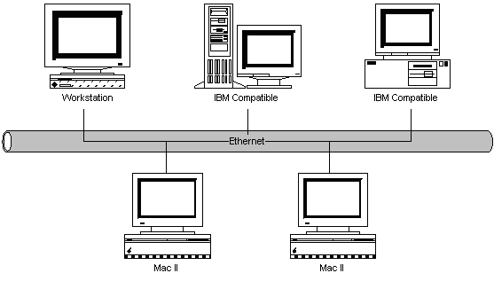
Data Link Layer
IP Header
TCP Header
payload
Challenge 1: Error
Bus Cable
Challenge 2: Conflicts
IP Header
TCP Header
payload
Notes:
A computer is practically connected to another network device (e.g., router, switch, and etc.) through certain physical media (e.g., cable).
Data link layer: Ethernet card, wireless adapter
The physical media might be
Unreliable => Introducing error to the packets
Shared => Introducing conflicts when sending packets

Slide 34
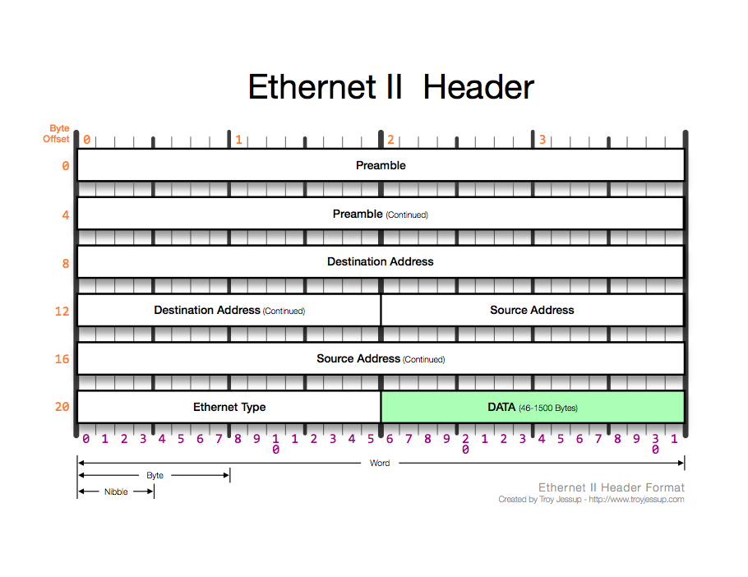
Data Link Layer
Ethernet Header
Notes:
Data Link Layer: Ethernet, cellular

Slide 35
Data Link Layer
Ethernet Header
IP Header
TCP Header
payload
Bus Cable
Notes:
A computer is practically connected to another network device (e.g., router, switch, and etc.) through certain physical media (e.g., cable).
The physical media might be
Unreliable => Introducing error to the packets
Shared => Introducing conflicts when sending packets

Slide 36
Application Layer
Protocols that support functions based on the services provided by the transport layer
DNS
FTP
HTTP
IMAP
IRC
……

Slide 37
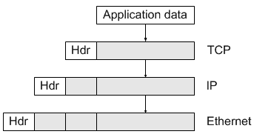
An Overview of TCP/IP Protocol Layers
application
transport
network
Data link
physical

Slide 38
Packet Sniffing and Parsing
Tools
TCPDUMP/WireShark
Ngrep
……
Programming
Writing your own packet sniffer
Notes:
Pcap, winpcap
The honeypot project

Slide 39

Libpcap
A collection of APIs for a program to capture packets from a network interface
Application
Libpcap
packet
packet

Slide 40
TCPDUMP
Parameter | Comments
-i | The network interface to monitor
-w | The pcap file to write
-r | The pcap file to read
-nn | Do not resolve names for IP addresses and Port numbers
-S | Print the absolute number for TCP sequence and acknowledgement
-XX | Show every bytes in a packet in both Hex and ASCII format

Slide 41
TCPDUMP
tcpdump -i eth0 -c 500 -s 0 -w test.pcap
tcpdump -r test.pcap -e -nn -S –XX
tcpdump -r test.pcap -e -nn -S -XX proto TCP
tcpdump -r test.pcap -e -nn -S -XX proto UDP
tcpdump -r test2.pcap -e -nn -S -XX 'tcp[13] & 2!=0’
tcpdump -r test2.pcap -e -nn -S -XX 'tcp[13]=18’
tcpdump -r test2.pcap -e -nn -S -XX 'tcp[13] & 2!=0' and 'tcp[13]!=18'

Slide 42
Demo - Using Wireshark
Wireshark:
Packet sniffer/protocol analyzer
Open Source Network Tool
Three windows:
Listing of captured packets
Details of selected packet header
Packet content in hexadecimal and ASCII
Notes:
Wireshark: The value of Header length field, when multiplied by 4, gives the number of bytes contained in the header.
Octet = 8-bit number (usually we call this a byte, but old DEC systems used 7-bit bytes) = values 0-255

Slide 43
End

